Slide 1
Embarking on a LMS Switch: Approaches to the Selection Process

Slide 2
Panelists
University of Waterloo: Andrea Chappell
ANGEL to Desire2Learn
University of Alberta: Scott Delinger
Various Blackboard & Moodle to Moodle 2.0
University of Lethbridge: David Hinger
Blackboard WebCT to Moodle
McGill University: Maggie Lattuca
Still in suspense ☺

Slide 3
uWaterloo LMS background
28,000 students; 1300 (70%) courses in LMS
LMS history
2000 – 2003: Homegrown pedagogical “front end”
Initially Blackboard for back end tools, then ANGEL
Summer 2004 – present: ANGEL
May 2009: Blackboard buys ANGEL … project struck
Coming from a “happy place” … one LMS for campus, pretty happy with it

Slide 4
Serendipitous Pre-project
Oct. 2008 – Apr. 2009: Online Learning Environment Review Project
Student survey (7000 responses to 5 multiple choice, 1100 responses to open question)
Faculty focus session (~30 from across spectrum)
Scan LMS landscape, Web 2.0/social, cloud, etc.
Concluded: Better “live”, math, audio/video (extensible), and mobile … but keep ANGEL ☺

Slide 5
Overview of selection process
Specifications: Fall 2009 – March 2010
RFI: May 2010
RFP: Aug. 2010
Evaluate RFP, Open Source: Sep. – Dec. 2010
Recommendation to university IT: Feb. 2011
Award to Desire2Learn: early March 2011

Slide 6
Preparing for Process – Tips
Understand your campus LMS culture
Still want/need an LMS?
Want out-of-box or demand lots of change?
Do you know you want Open Source?
Is the project team complete?
Core team: IT & pedagogical support, distance ed, Library, “the faculty”, “the students”
Resource: Bookstore, Analytics, Emerging tech

Slide 7
Input from constituents – Tips
Focus requested input, but also leave opportunity for open comment.
Student survey inquired about mobile access, communication tools, learning experience, + open question.
Instructor focus groups were asked, What works, what doesn’t, what you’d like to see?

Slide 8
RFI/RFP Specifications – Tips
Focus less on basic, more on your scenarios
Functionality – we divided into 4 sections:
Basic (expected in all LMSs) – respondents confirm or explain deviations – less work!
Specialized (beyond Basic, and on which we rely); e.g., teams, repositories, automation
Integration and extension capabilities
Desirable (e.g., math, a/v communications, ePortfolio, mobile strategies, content mgmt)

Slide 9
RFI – Tips
Why do you want one? We used it to:
“Beat the bushes” (Who will respond)
Test specs (Got answers we wanted?)
Ask open-source specific questions.
Received 9 responses (but, only 4 to RFP!)
Do it again? Not so sure.
Helped get the RFP right.
But, longer process, maybe lost RFP respondents.

Slide 10
RFP – Tips
If plan to include “from source” Open Source, say so in RFP (Purchasing happier).
Know how to assess RFP rating scheme
If team does all sections together, take average or mean or ? What to do with outliers?
Or, make small groups responsible for marking some sections?
Keep notes on why mark areas down in case challenged by vendors.

Slide 11
Implementation
How aggressively do you want to move?
“Rip off the bandage” (quick move to one system)
Take time for thoughtful change (e.g., for greater consistency and to take advantage of new system)
Start with “robust” instructors who can deal with change and challenges
Be ready to accept new ways of doing things
Opportunities may present themselves!

Slide 12
UAlberta LMS background
37,600 students; 2300 courses in LMS in fall/winter
LMS history
1998 – 2010: WebCT – Blackboard Vista 8
Centrally supported
2004: AB School of Business adopts Blackboard
2005 – 2010: Moodles pop up
2009: LMS Review says adopt Moodle, keep Vista
Summer 2010: Evaluation of LMS options
Fall 2010: Moodle selected as next LMS

Slide 13
Overview of selection process
Read 2009 LMS report
Summer 2010
Arm’s-length from CIO review process
meet with University community
Eval Vista, Learn, Moodle tools in use/requested
Issue Evaluation Team report, get feedback
Oct 4, 2010: Moodle announced
Moodle 2.0 pilot run Winter Term 2011

Slide 14
Implementation – Tips
Timeline
~6000 course sections by Jan 2013
Pilot w/enthusiastic experimenters
Capture all feedback, address issues, inform training
Courses selected to represent many types
Take calculated risks
Oversight Committee
Project Team: PM, sw, hw, train, comms, owners

Slide 15
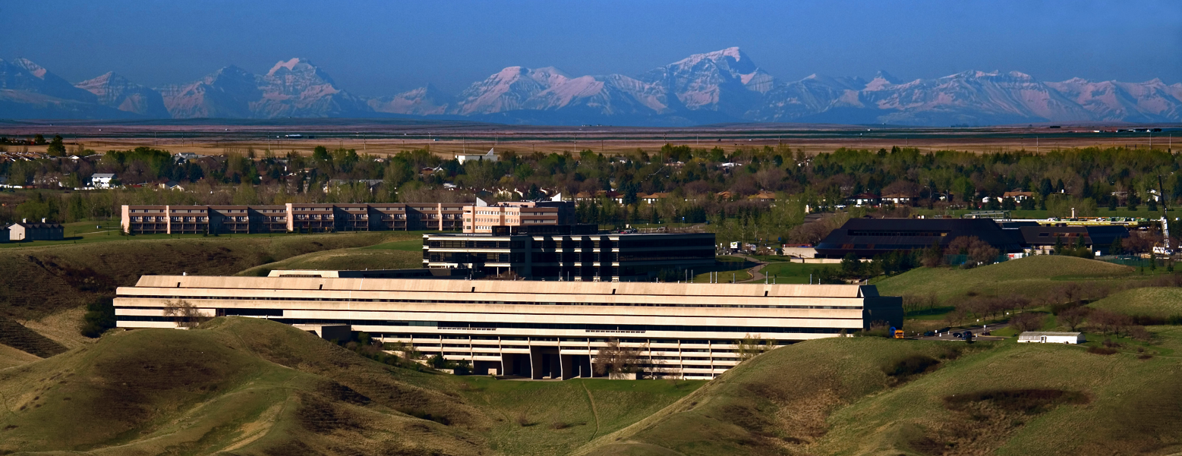
Moving to Moodle
David Hinger

Slide 16
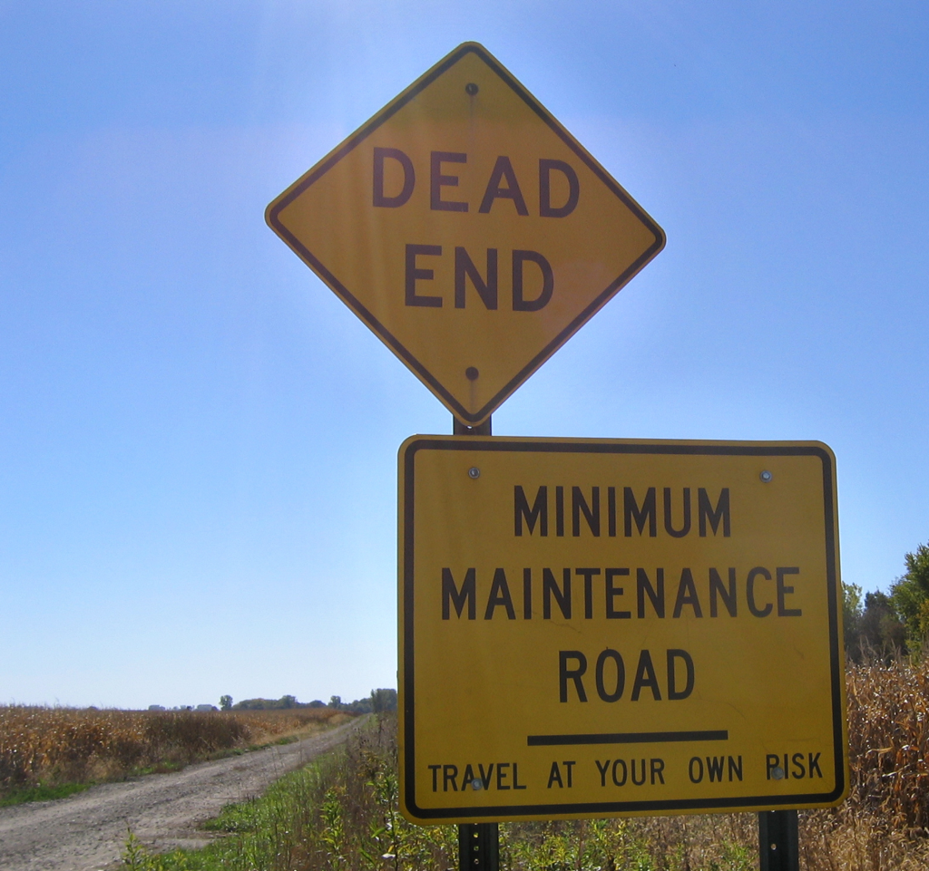
WebCT (Blackboard CE)
Started - September 1999
Blackboard purchased - 2006

Slide 17
Options
Move to Blackboard Learn
Move to an alternative LMS
Both will require the same amount of time, money and effort!

Slide 20
LMS Transition Steering Committee

Slide 21
Evaluation Process

Slide 27
How do we Make the Move?

Slide 28
Communication Strategy
Moodle

Slide 29
Meet Steve

Slide 32
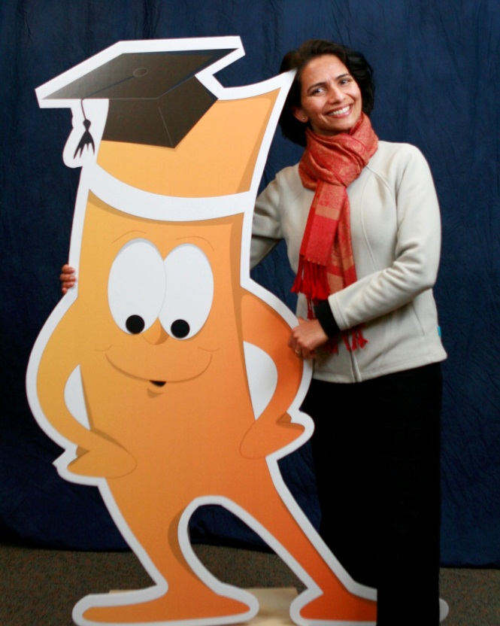
Get your picture
with Steve
Moodle Swag

Slide 33
Create a Sense of Urgency It’s Here Poster Todd’s Videos How do I Move

Slide 34
How do we design a new
Moodle for the U of L?

Slide 36
Blue Sky Ideas
Lets start from scratch - What do you want to see.
Not constrained by the limitations of the technology!

Slide 37
LMS Design Game
Design your own LMS
Posterboard puzzle
Tactile exercise
Had to work out Navigation issues

Slide 38
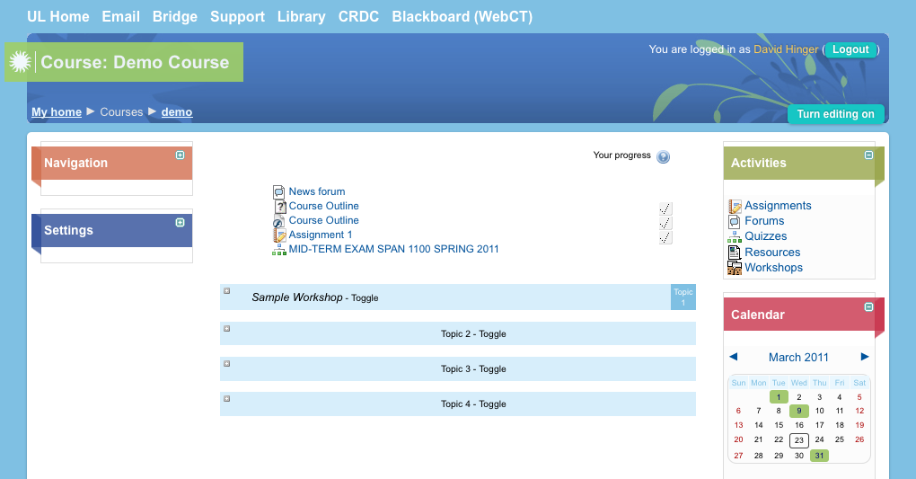
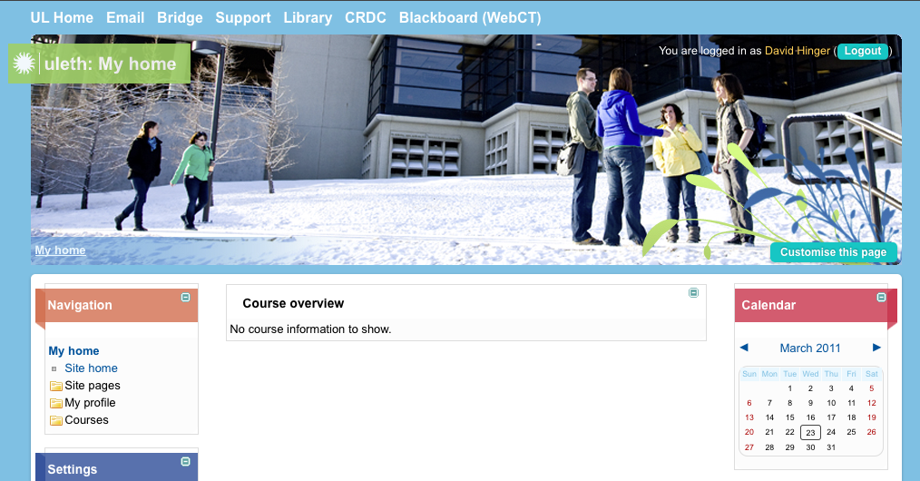
U of L Moodle Theme

Slide 39
McGill Background
36,531 students
1,627 tenured and tenure-stream faculty
11 faculties and 10 schools
WebCT since 1998
WebCT Vista since 2005
Over 20,000 course sections
72% faculty employ the LMS

Slide 40
User Requirements
2009-2010
Use Case model
31 instructors, representing 11 faculties
8 students, from various departments
15 administrative staff, from 7 departments that support teaching and learning

Slide 41
Findings
Faculty
Collaboration tools
Open content
Students
Collaboration tools
Customization of online learning environment
Staff
Collaboration tools
Open content

Slide 42
Project Structure
Executive Committee
Sponsor - Provost
Project Team (RFI)
Consultation Group – Pedagogy
Consultation Group – Technology
Selection Team (RFP/CFT)

Slide 43
RFI
2010-2011
What don’t we already know?
Opportunity to evaluate open source
Refine our requirements, test them
Involve and hear from our community

Slide 44
RFI
2 proprietary solutions
2 service providers for Moodle
1 service provider for Sakai – too late!
Are we ready for open source?
Consulted with Canadian and American universities

Slide 45
RFI
Full day vendor demos (x 4)
Morning dedicated to pedagogy
Afternoon dedicated to technology
Online evaluation form
Opportunity to ask questions, vendor or Educational Technologies (used back channel)
Instructor, student, staff ‘sandboxes’
Sample courses migrated (evaluation form)

Slide 46
What We Learned
Mandatory and general requirements
Open to hosted options
Definitive requirements, yes or no
Short overview of solutions by vendor
Simplified evaluation forms
Would we do it again?
Yes!

Slide 47
RFP/CFT
Released in May 2011
Anticipate decision end June

Slide 48
Implementation
1st pilot, January 2012
2nd pilot, May 2012
Go live, September 2012

Slide 49
For more information …
uWaterloo: andrea.chappell@uwaterloo.ca
http://ist.uwaterloo.ca/projects/lms_selection
Alberta: scott.delinger@ualberta.ca
http://www.moodle.ualberta.ca/
Lethbridge: hingde@uleth.ca
http://www.uleth.ca/crdc
McGill: maggie.Lattuca@mcgill.ca
http://blogs.mcgill.ca/mycourses

